Slide 1

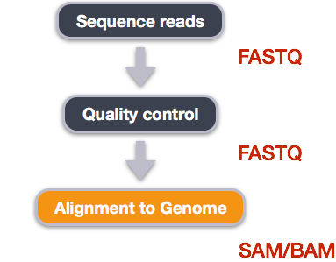
FASTQC

Slide 2
Overview for today’s lecture
Job Submission recap
SLURM directives
.out files
FASTQC

Slide 3
Why submit a job?
It will be annoying to run each sample, one by one:
htseq-count -f bam -s yes -i gene_name -m union sample1.bam annotation.gtf > sample1.count.txt
WAIT FOR IT TO RUN
htseq-count -f bam -s yes -i gene_name -m union sample2.bam annotation.gtf > sample2.count.txt
WAIT FOR IT TO RUN
Also, some programs…. take a very long time to run!

Slide 4

Submitting a job
Submitting a job to an HPC machine (such as Bluemoon) is done using the batch system.

Slide 5
Submitting a job
The batch system allows users to submit jobs requesting the resources (nodes, processors, memory, GPUs) that they need.
The jobs are queued and then run as resources become available.
All jobs (scripts with file extension .sh) are submitted to a batch system called SLURM

Slide 6
BASIC STEPS:
1. Log in to VACC
2. Write job script
3. Submit Job
4. Monitor job and wait for it to run
5. Retrieve your output

Slide 7
BASIC STEPS:
1. Log in to VACC
2. Write job script
3. Submit Job
4. Monitor job and wait for it to run!
5. Retrieve your output
Requires an understanding of SLURM directives

Slide 8
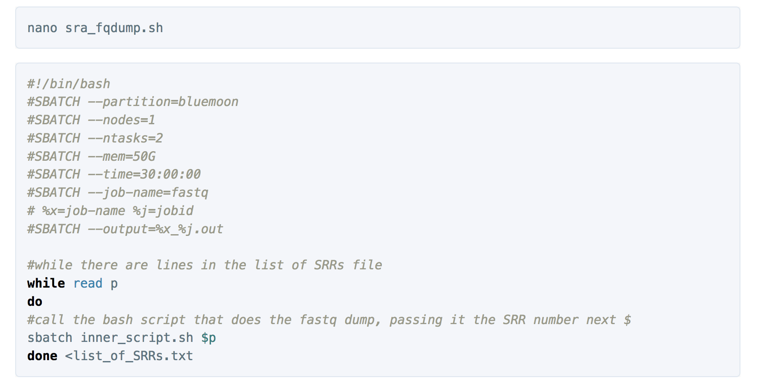
Quick look inside sra_fqdump.sh
1.
SLURM DIRECTIVES
2.
CODE

Slide 9
What are SLURM Directives?
At the top of the job script will always be several lines that start with #SBATCH.
The SLURM directives provide the job setup information used by Slurm.
This information is then followed by the commands to be executed in the script.

Slide 10
Common slurm directives
#!/bin/bash
#SBATCH --partition=bluemoon
#SBATCH --nodes=1
#SBATCH --ntasks=4
#SBATCH --mem=50G
#SBATCH --time=30:00:00
#SBATCH --job-name=RNAseq
# %x=job-name %j=jobid
#SBATCH --output=%x_%j.out

Slide 11
Common slurm directives
#!/bin/bash
#SBATCH --partition=bluemoon
#SBATCH --nodes=1
#SBATCH --ntasks=2
#SBATCH --mem=50G
#SBATCH --time=30:00:00
#SBATCH --job-name=RNAseq
# %x=job-name %j=jobid
#SBATCH --output=%x_%j.out
shebang = used to tell the linux OS which interpreter to use

Slide 12
Common slurm directives
partition = default is bluemoon if not specified
Other partitions are available.
This is important to know as some jobs will take longer to run!
#!/bin/bash
#SBATCH --partition=bluemoon
#SBATCH --nodes=1
#SBATCH --ntasks=2
#SBATCH --mem=50G
#SBATCH --time=30:00:00
#SBATCH --job-name=RNAseq
# %x=job-name %j=jobid
#SBATCH --output=%x_%j.out

Slide 13
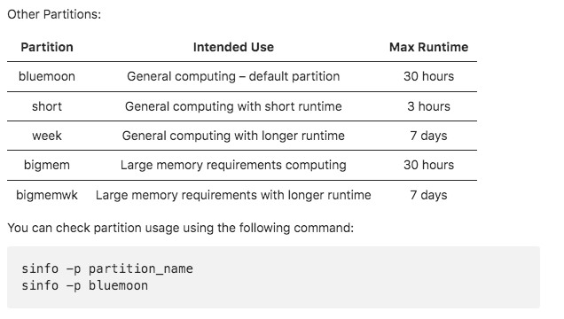

Slide 14
Common slurm directives
Node: A “node” is a server in the cluster. Each node has is configured with a certain number of cores (CPUs).
Task: A “task” is a process sent to a core. By default, 1 core is assigned per 1 task
Recommend that you begin with 1 node and 2 processes
#!/bin/bash
#SBATCH --partition=bluemoon
#SBATCH --nodes=1
#SBATCH --ntasks=2
#SBATCH --mem=50G
#SBATCH --time=30:00:00
#SBATCH --job-name=RNAseq
# %x=job-name %j=jobid
#SBATCH --output=%x_%j.out

Slide 15
Common slurm directives
#!/bin/bash
#SBATCH --partition=bluemoon
#SBATCH --nodes=1
#SBATCH --ntasks=2
#SBATCH --mem=50G
#SBATCH --time=30:00:00
#SBATCH --job-name=RNAseq
# %x=job-name %j=jobid
#SBATCH --output=%x_%j.out
If your job requires more than 1G of memory – need to specify this

Slide 16
Common slurm directives
#!/bin/bash
#SBATCH --partition=bluemoon
#SBATCH --nodes=1
#SBATCH --ntasks=2
#SBATCH --mem=50G
#SBATCH --time=30:00:00
#SBATCH --job-name=RNAseq
# %x=job-name %j=jobid
#SBATCH --output=%x_%j.out
Walltime is the maximum amount of time your job will run.

Slide 17
Common slurm directives
#!/bin/bash
#SBATCH --partition=bluemoon
#SBATCH --nodes=1
#SBATCH --ntasks=4
#SBATCH --mem=50G
#SBATCH --time=30:00:00
#SBATCH --job-name=RNAseq
# %x=job-name %j=jobid
#SBATCH --output=%x_%j.out
Make unique-add userid or some other identifier

Slide 18
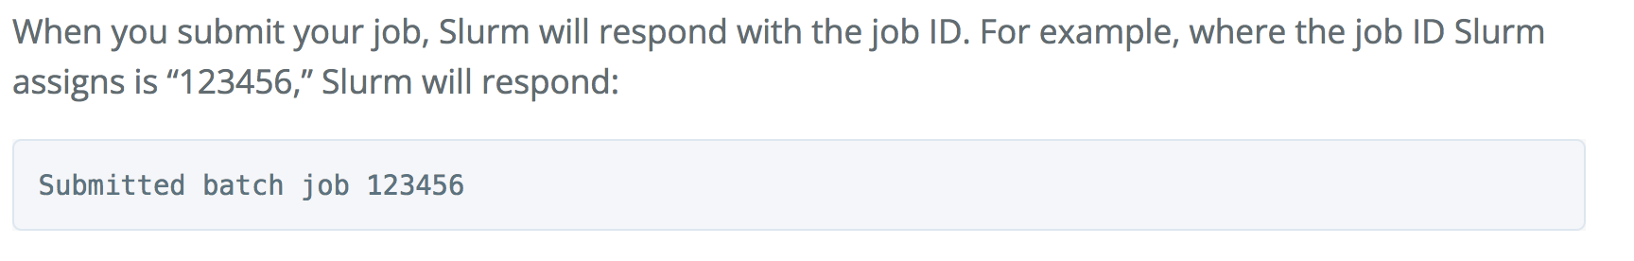
To run script use sbatch command:
sbatch sra_fqdump.sh

Slide 19
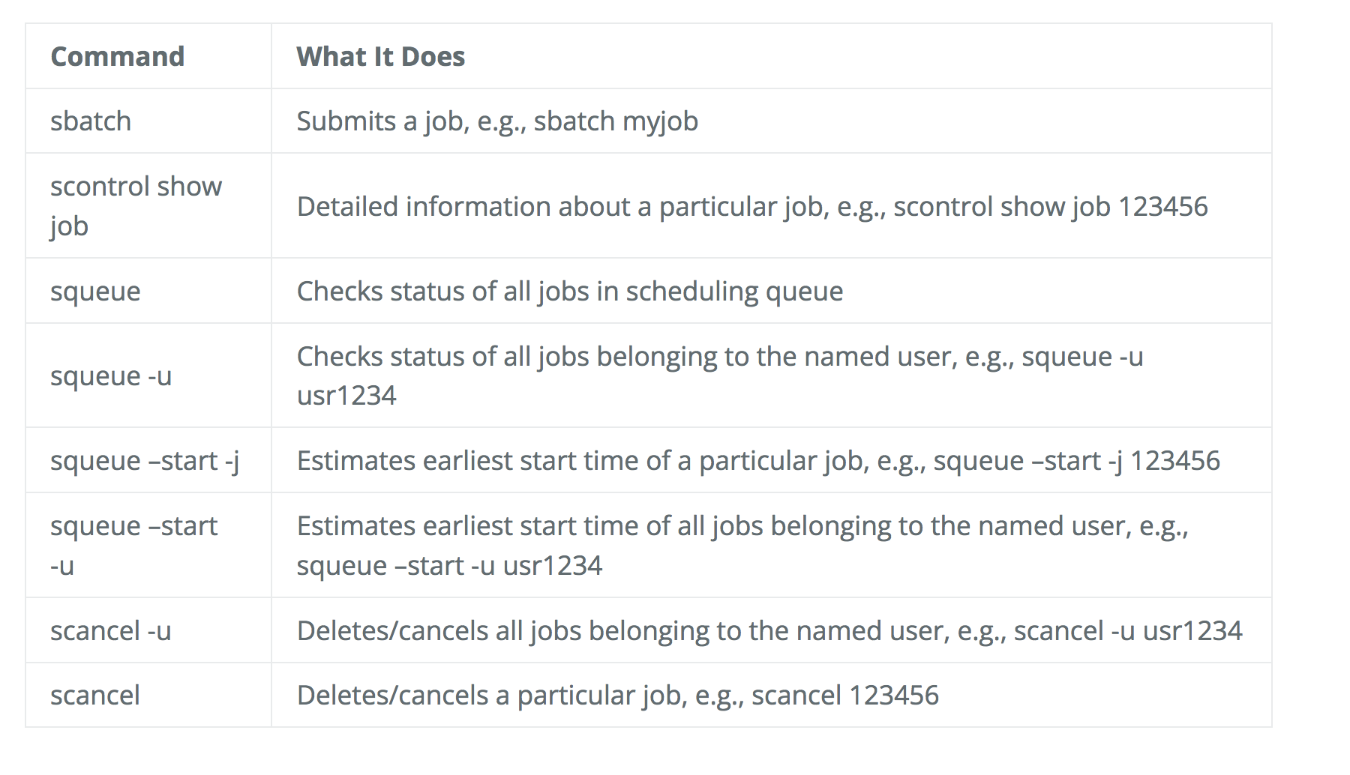
Other important commands:

Slide 20
Fastq-dump --gunzip SRR#1 -> .out file #1
Fastq-dump --gunzip SRR#2 -> .out file #2
Fastq-dump --gunzip SRR#3 -> .out file #3

Slide 21
Recording the output of programs
Three data streams exist for all Linux programs
STDIN (Standard Input - a way to send data into the program)
STDOUT (Standard Output - a way to send expected data out of the program)
STDERR (Standard Error - a way to send errors or warnings out of the program)
STDOUT STDERR
STDIN
program
By default STDOUT and STDERR are connected to your shell, so when you see text coming from a program, it's coming from these streams.

Slide 22
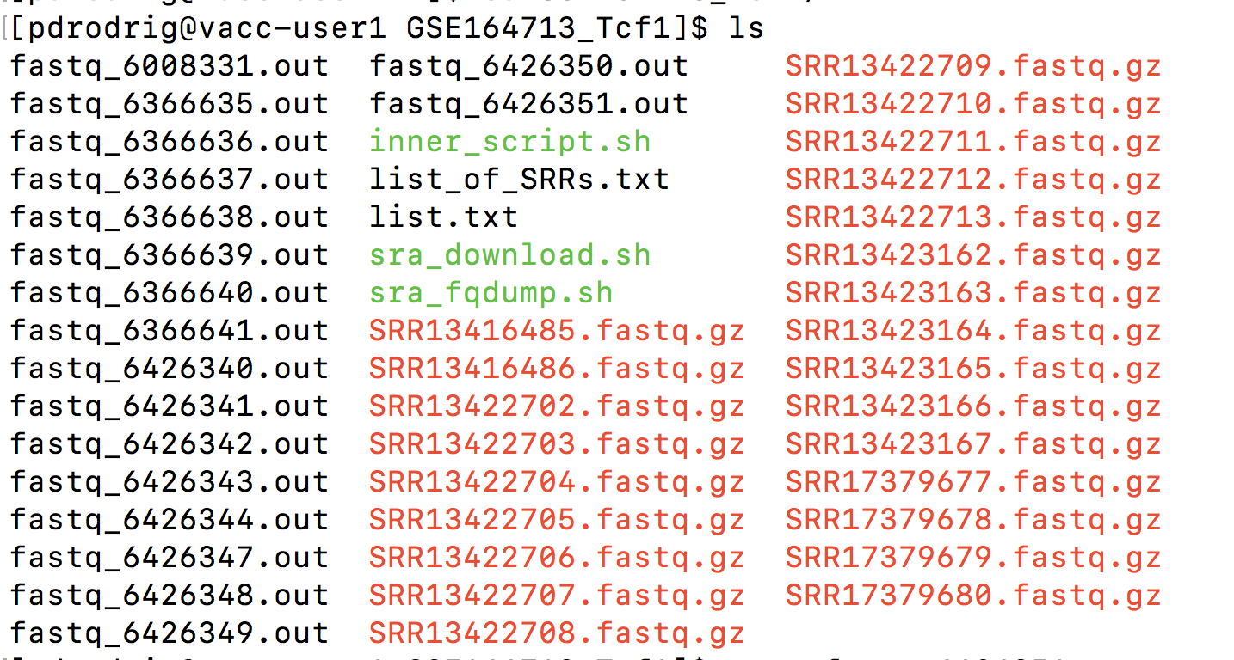
These will be redirected to .out files

Slide 23
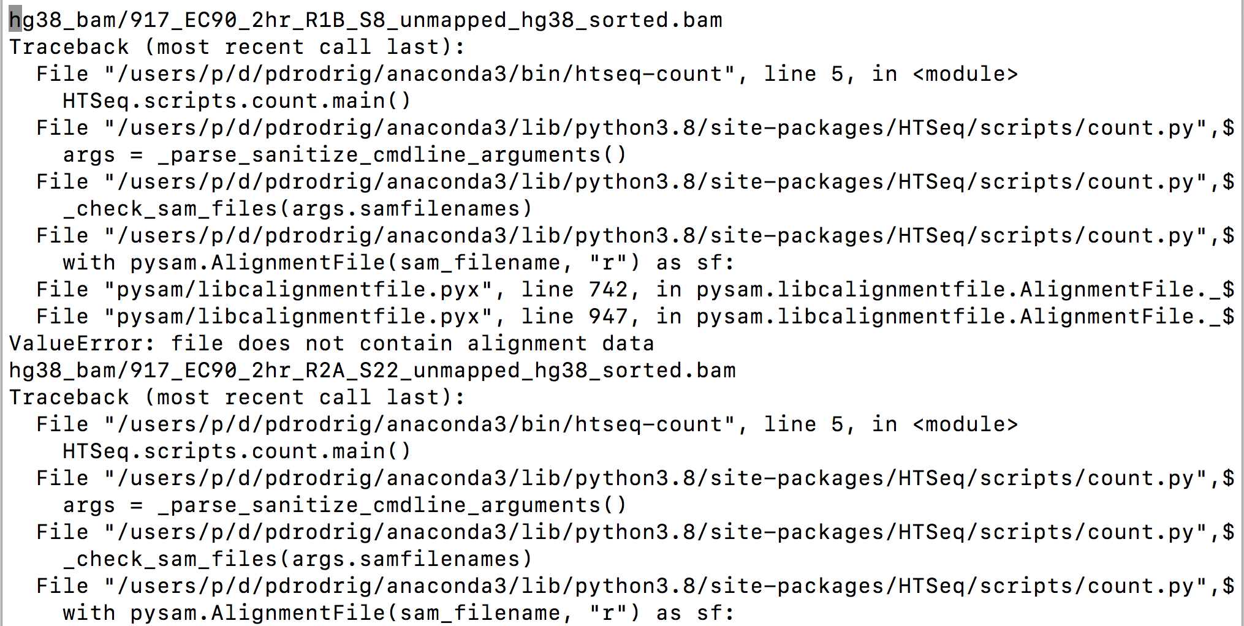
Any errors will be recorded in these .out files

Slide 24
Data management planning
What types of intermediate data files will I generate?
Consider the datatype and file sizes. How much total raw data do you have?
Consider the type of analyses you plan on performing.
What is the best way to organize my directory structure?

Slide 25
Keep
Delete
Delete
FASTQ.gz
Trimmed.FASTQ.gz
SAM
2-5GB
2-5GB
12-15GB
Keep
BAM
> 1GB
Files you are collecting using sratoolkit
Fastq-dump
You will need to collect information about the data you are processing

Slide 26


Data types: Raw data
For NGS experiments, these are the FASTQ files you obtain from your sequencing facility or GEO
This data should never be directly modified (i.e. always keep a copy of this stored somewhere, untouched from its original state)

Slide 27
Metadata
Metadata are data that provide information about the data you are processing
Metadata exists to give data context
In genomics or transcriptomics, metadata describes the sample that the DNA/RNA sequence was obtained from, the organism, the cell line, and library preparation method

Slide 28
Workflow
Raw Reads
Quality control (FASTQC)

Slide 29
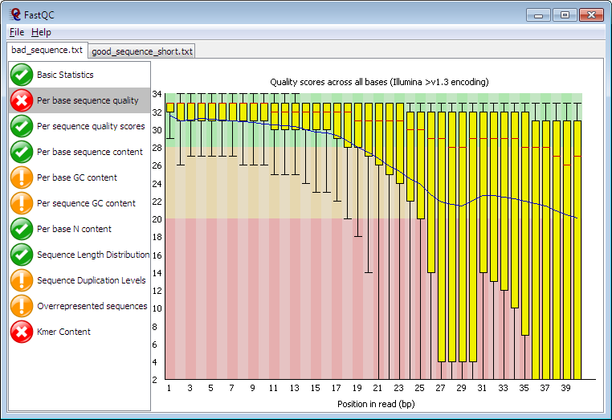
FastQC
Reads raw fastq files as input
Performs multiple checks
Pass/warn/fail
Compares to genomic library
HTML Report
http://www.bioinformatics.babraham.ac.uk/projects/fastqc/

Slide 30
Sequence Output Format
FASTQ
Line 1: Unique ID for a sequencing read
Line 2: Sequences
Line 3:+
Line 4: Base calling quality score (American Standard Code for Information Interchange (ASCII) value)
Example:
@HISEQ:126:H14YJADXX:1:1101:1118:2101 1:N:0:ATCACG CTCCATAGTCAGAAACTTCAGCATGACAGTACCTCATGCTGCATCAGGTGATCATGAAAAGATTACAGGCTTTCTAAAATTATCAGCAAGATATGG
+ @@?ADDDD?ADHDIIIIIIIEIIIGEFHC<?FH4C9E9BGAFIGH<DG9BD?@DGGEGHHG<DCBBCC8C>FHCGEHIGEEE>EEHEEEEC>A>;;

Slide 31
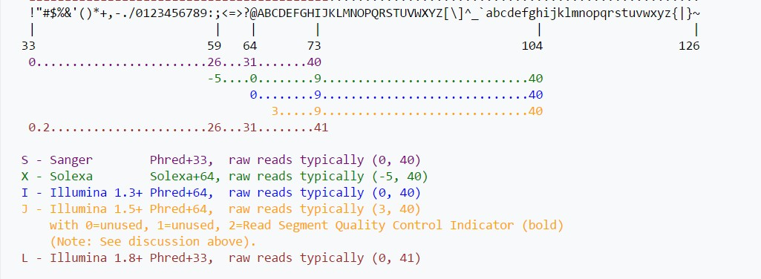
Quality Score Representation
Quality scores are represented as ASCII characters in order to save space, so that there is one ASCII character per base.
Converts between the ASCII value into Phred score

Slide 32
Base Call Qualities (Phred scores)
For most runs, quality should be good for most reads through the whole run
If quality deteriorates we should understand how and why
Good (Illumina) quality is generally Phred > 30
Concerning (Illumina) quality is Phred < 20

Slide 33
What should you look for in your libraries?

Slide 34
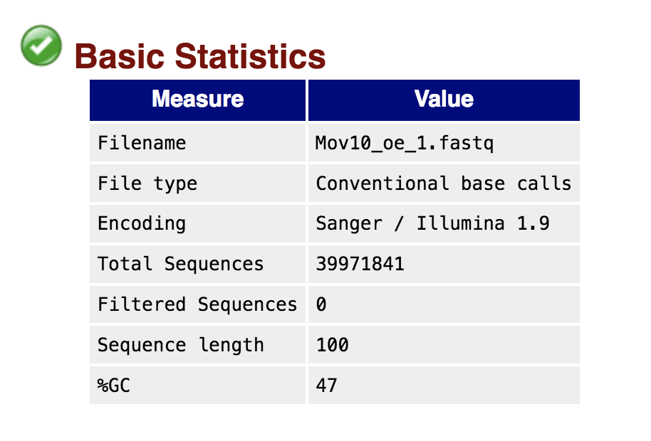

Slide 35
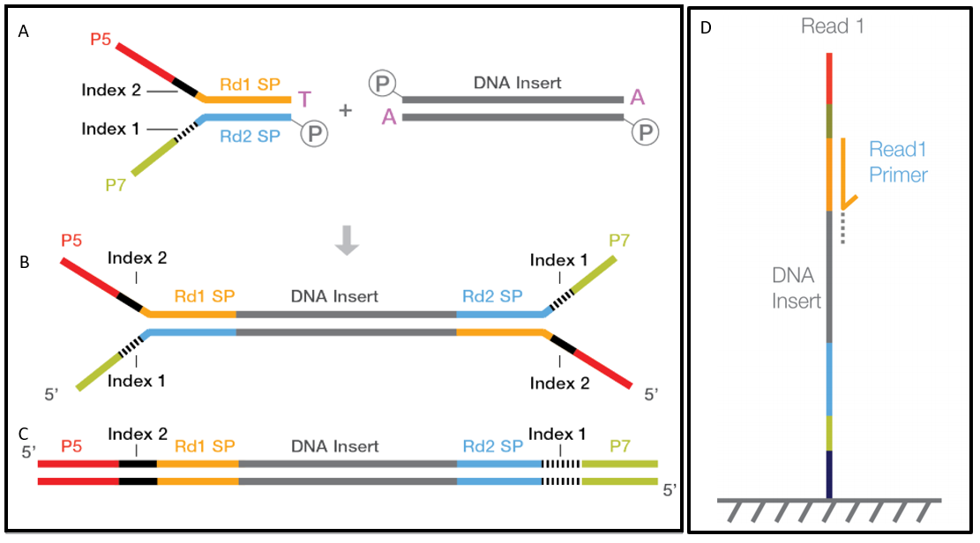
Architecture of Standard Illumina NGS library
P5 and p7 sequences are required to bind the flow cell
Adaptors will serve as primer binding sites for amplification and sequencing
Indices are used to combine many samples into 1 seq. run

Slide 36
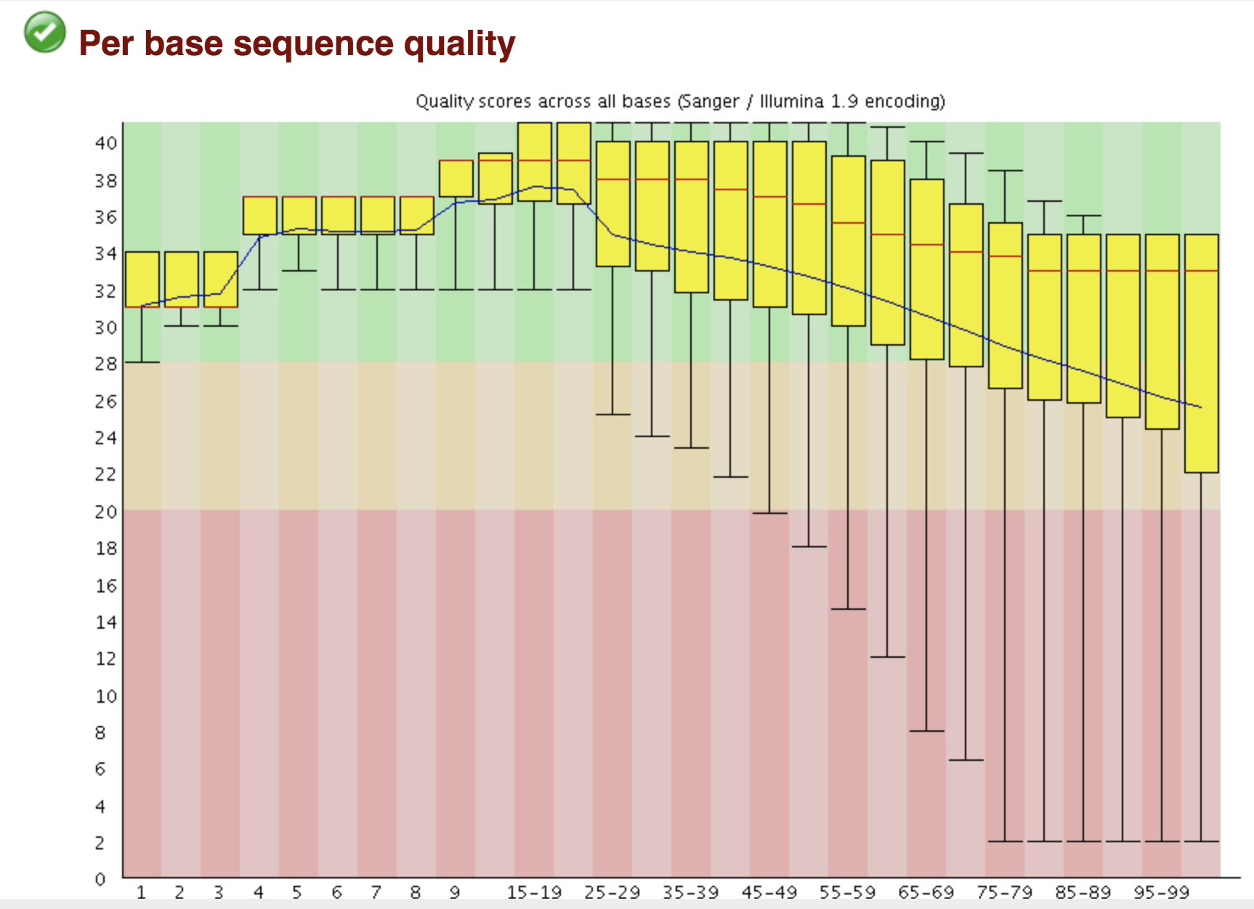
Phred Score
Cycles of Chemistry
For each position a BoxWhisker type plot is drawn.
The central red line is the median value
The yellow box represents the inter-quartile range (25-75%)
The upper and lower whiskers represent the 10% and 90% points
The blue line represents the mean quality

Slide 37
FastQC Report
PHRED Quality Score | Probability of incorrect base call | Base call accuracy
10 | 1 in 10 | 90 %
20 | 1 in 100 | 99 %
30 | 1 in 1000 | 99.9 %
40 | 1 in 10000 | 99.99 %
50 | 1 in 100000 | 99.999 %
Notes:
The higher the score the better the base call. The background of the graph divides the y axis into very good quality calls (green), calls of reasonable quality (orange), and calls of poor quality (red).

Slide 38
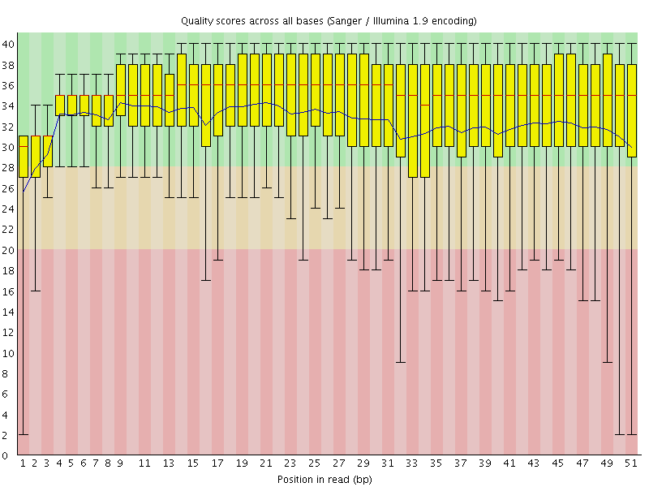
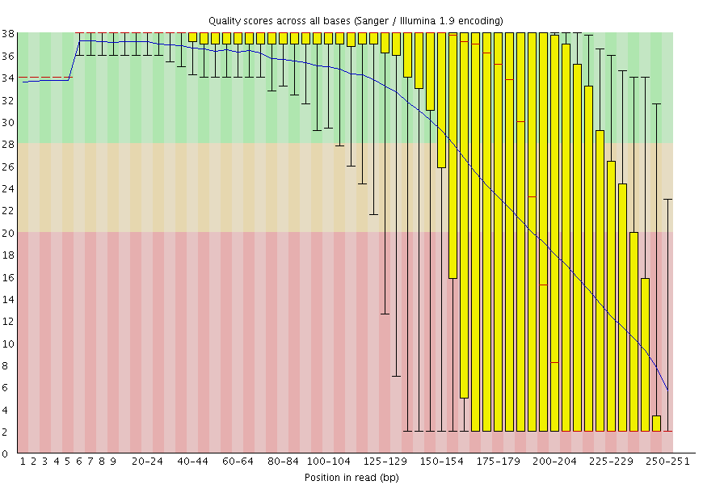
Base Call Qualities – Per Cycle
Read 1
Read 2
The quality of base call tend to degrade as the run progresses

Slide 39
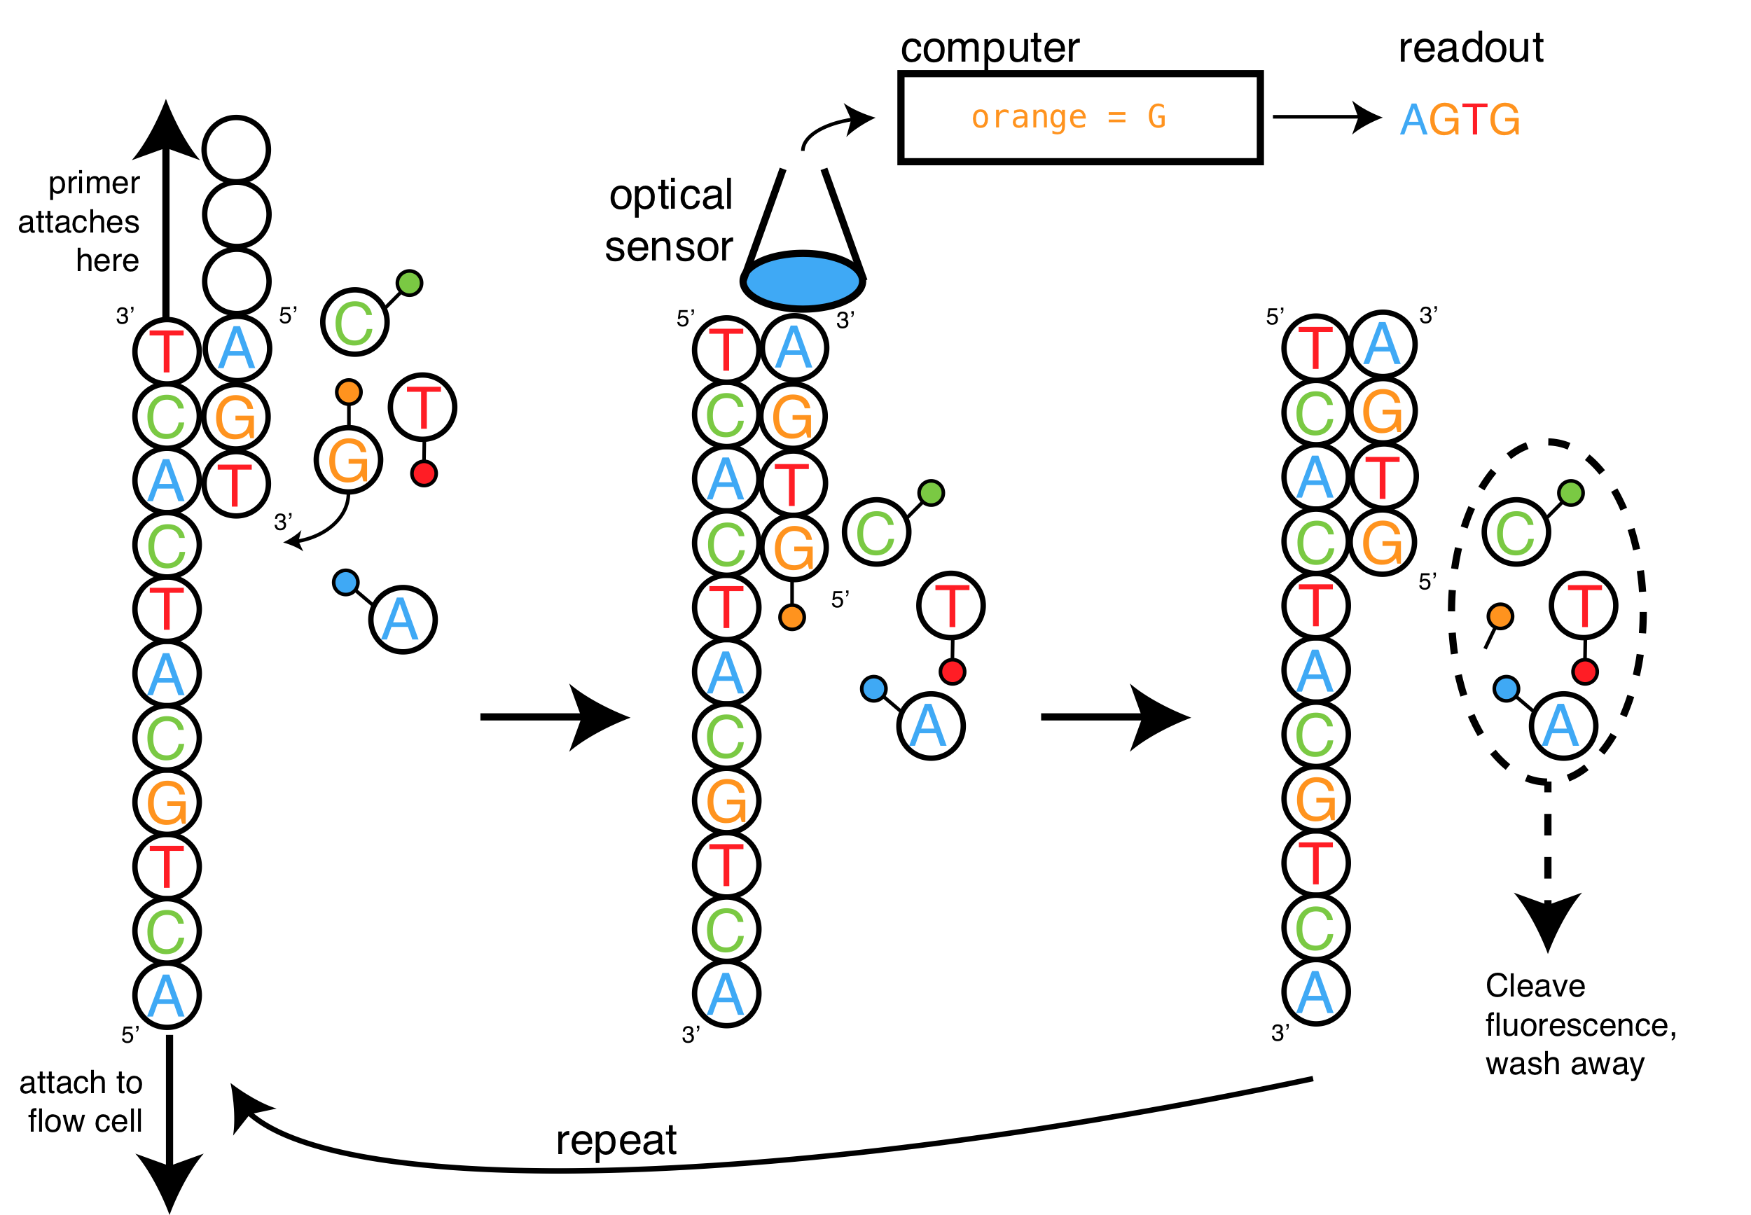
Then sequencing begins!
Have fluorescent-labeled nucleotides
Each dNTP has a corresponding color
During each cycle, a labeled dNTP is added to the growing chain
An image is then taken
Then the fluorescent dye is cleaved to allow for the next nucleotide to be incorporated in the next cycle

Slide 40
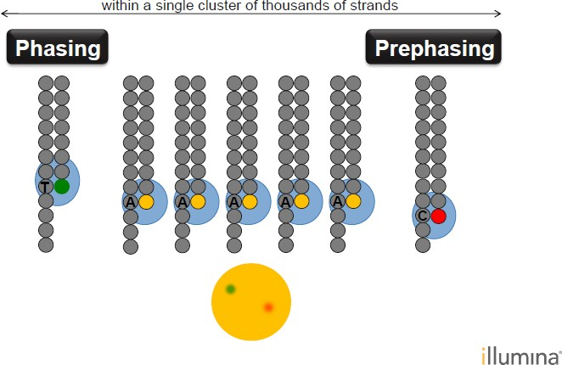
Problem
As the chain grows, signal quality deteriorates
At each cycle, accumulates noise
Solution
Sequence only (up to 300bp)
Enables robust base-calling across the genome including in repetitive sequence regions

Slide 41
Trimming
If the quality of the library falls to a low level then the most common remedy is to perform quality trimming where reads are truncated based on their average quality.
Trimming must be performed on all samples - Before committing to any action, check in

Slide 42
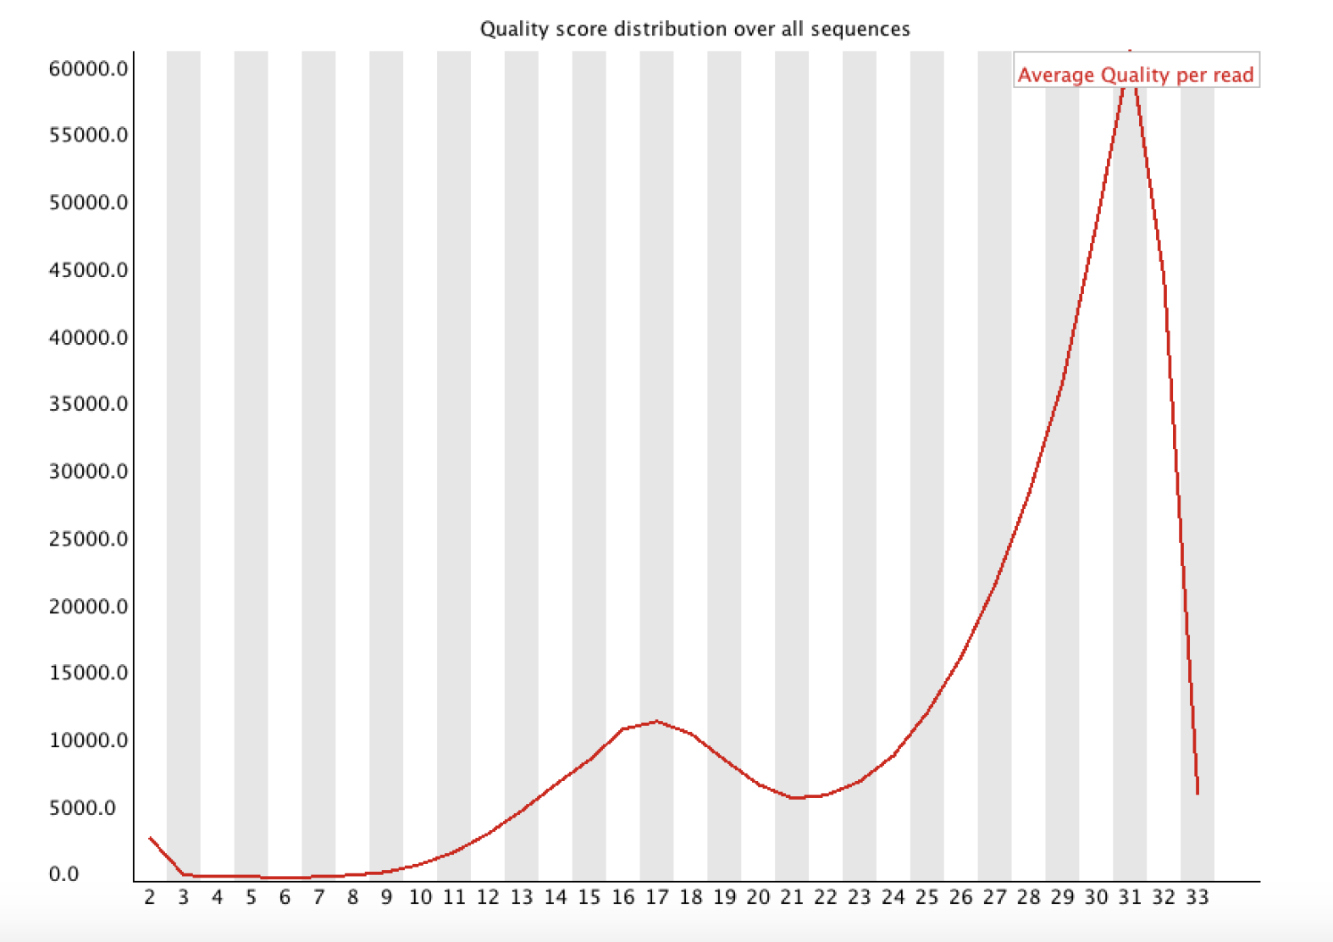
Is it a subset of the sequences that have low scores or is it the majority of them?
Per Sequence Quality Score
# of sequences
Phred score

Slide 43
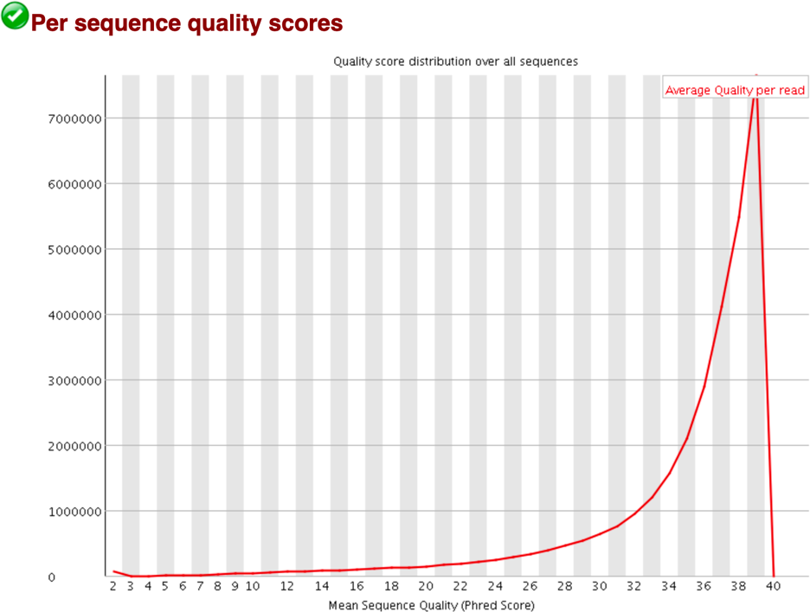
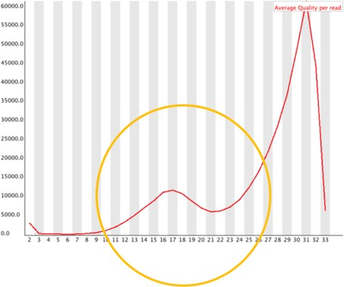
FastQC: per-read mean base qualities
(bad)

Slide 44
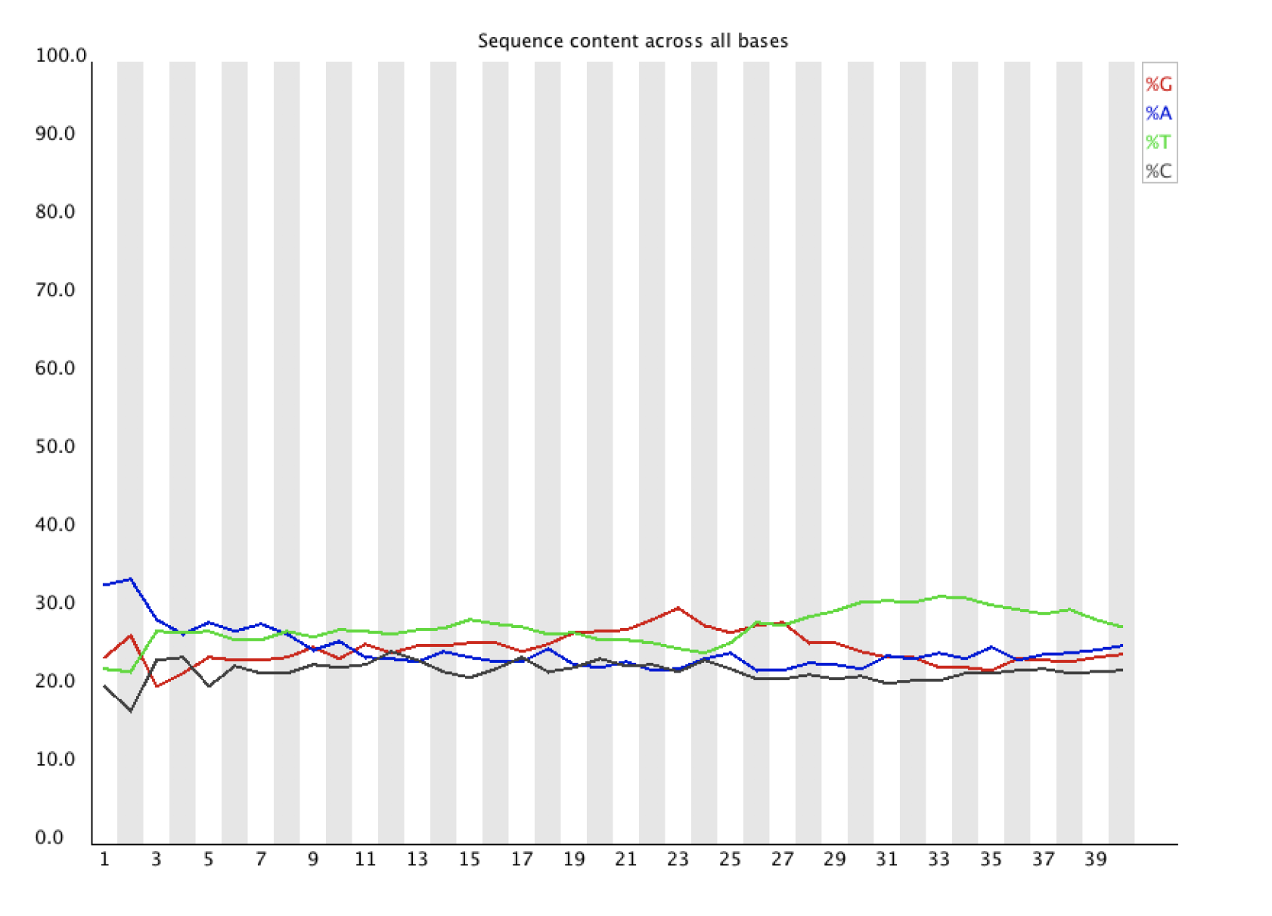
Per Base Sequence content
What is the proportion of each base in the file?
Percentage
If there are 4 bases out of 100% what is the gold standard?

Slide 45
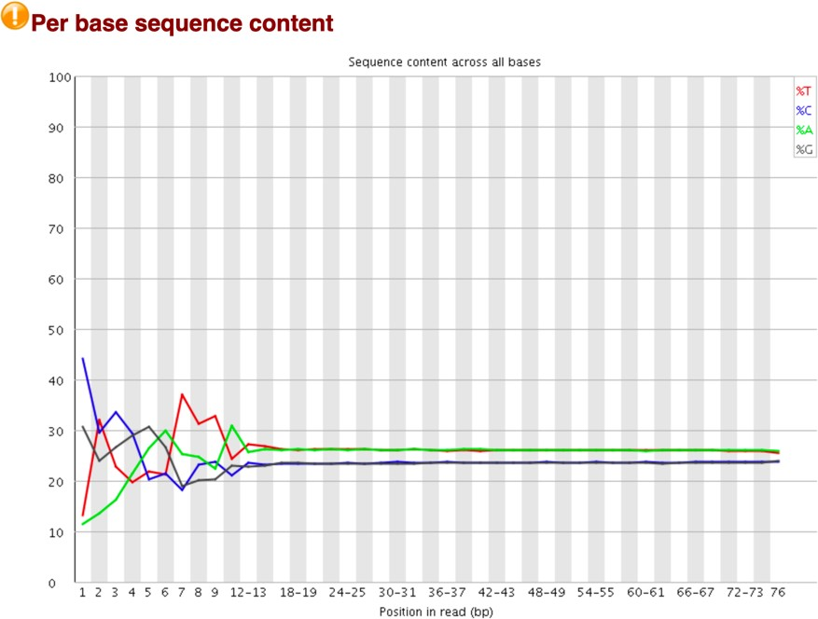
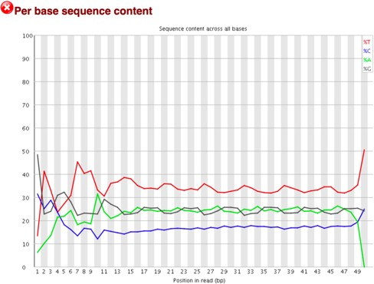
FastQC: %ACGT over read length
(bad)
If there is a strong preference, this indicates an overrepresented sequence

Slide 46
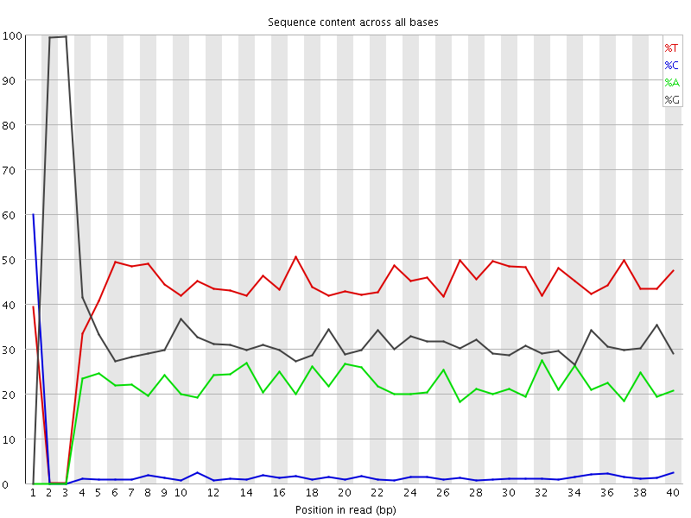
Library Base Composition
Bisulphite treated – C is converted to T

Slide 47
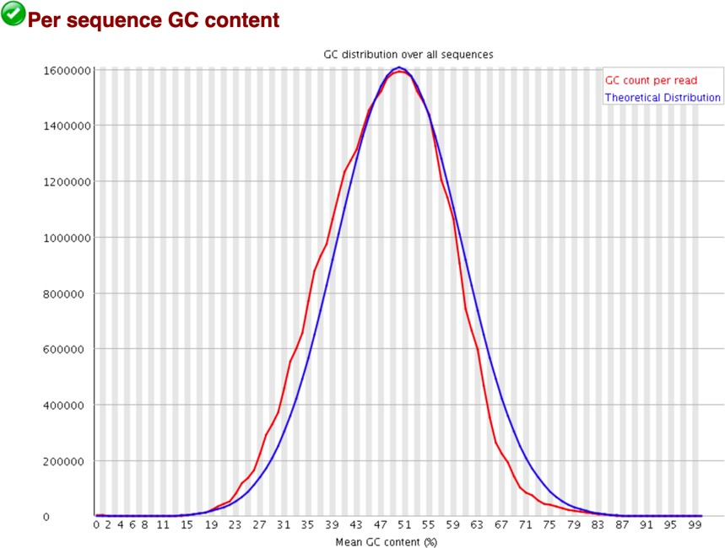
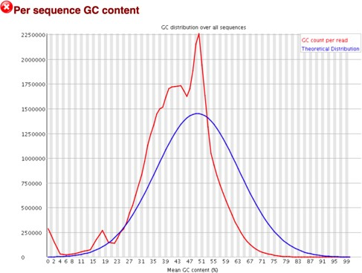
FastQC: per-read %GC
(bad)

Slide 48
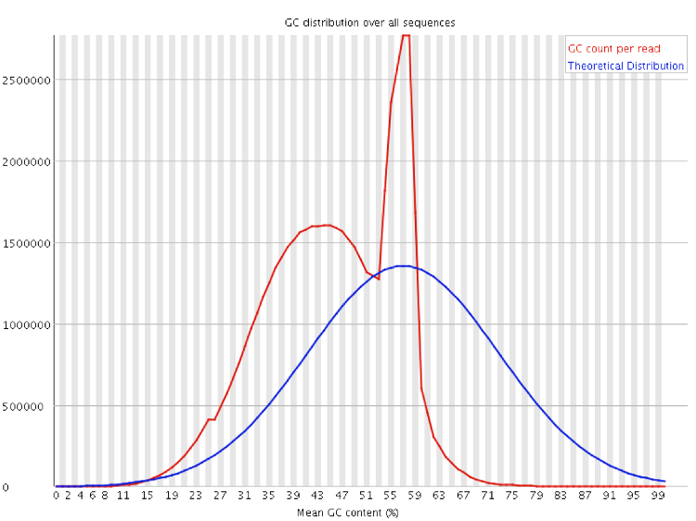
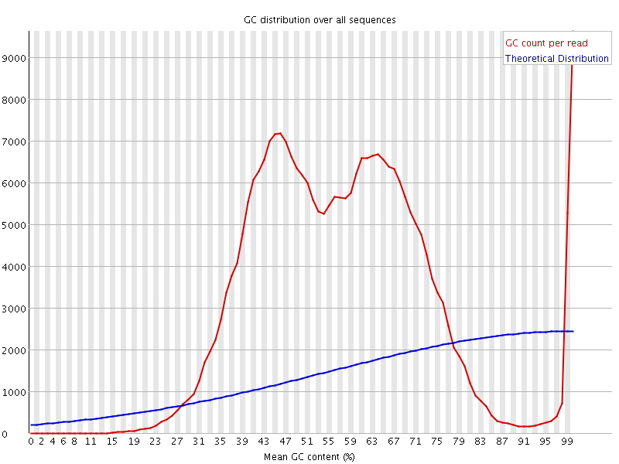
Library GC Content
Specific Contamination
Broad Contamination

Slide 49
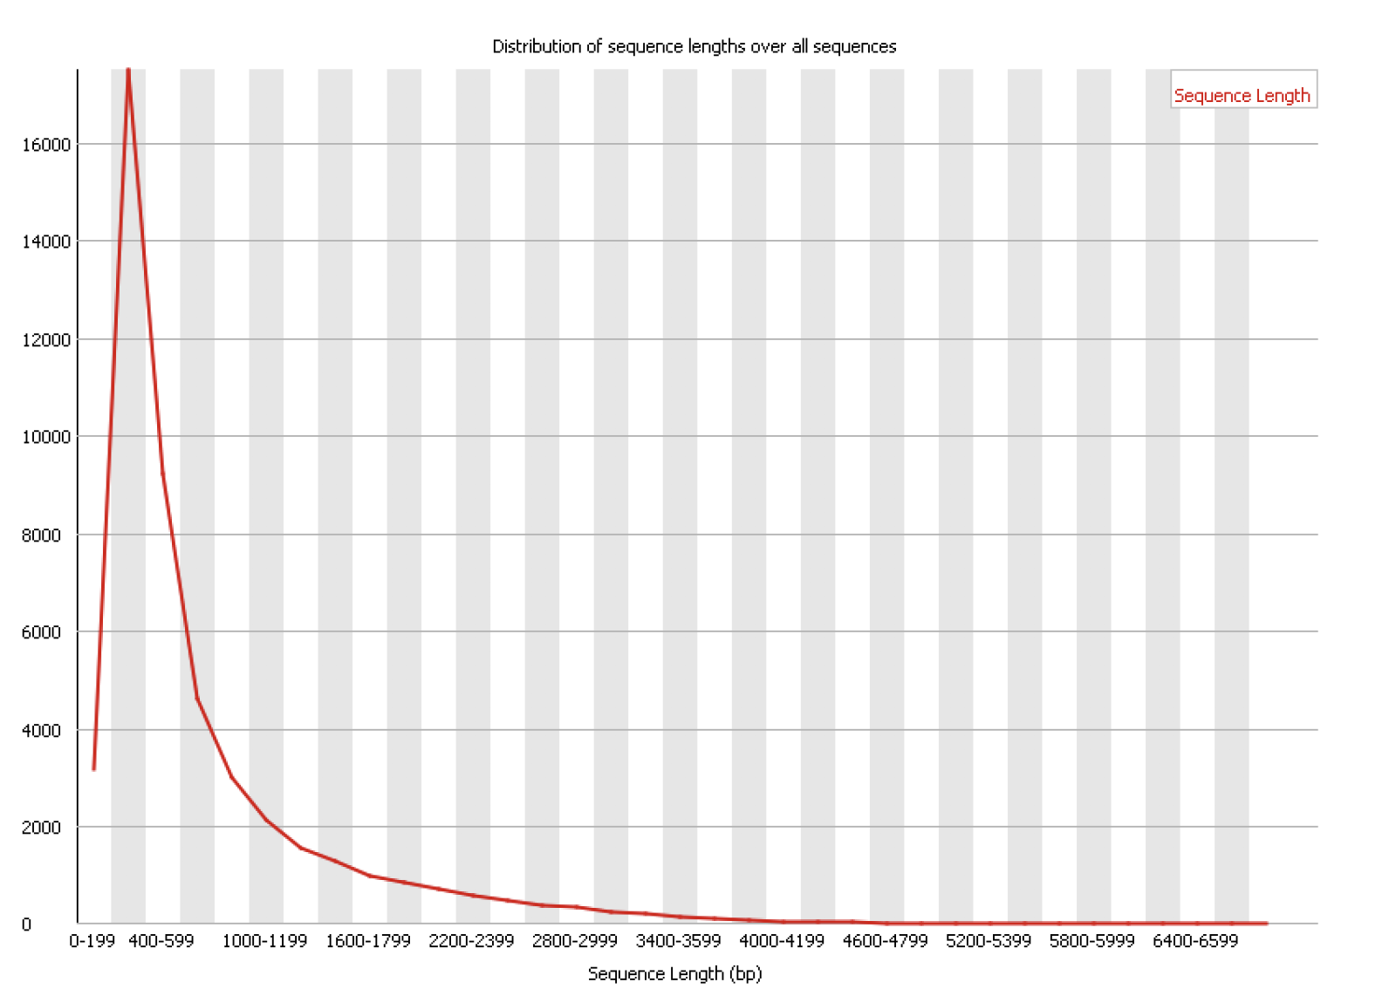
What is the average fragment length?
# of sequences
Sequence length

Slide 50
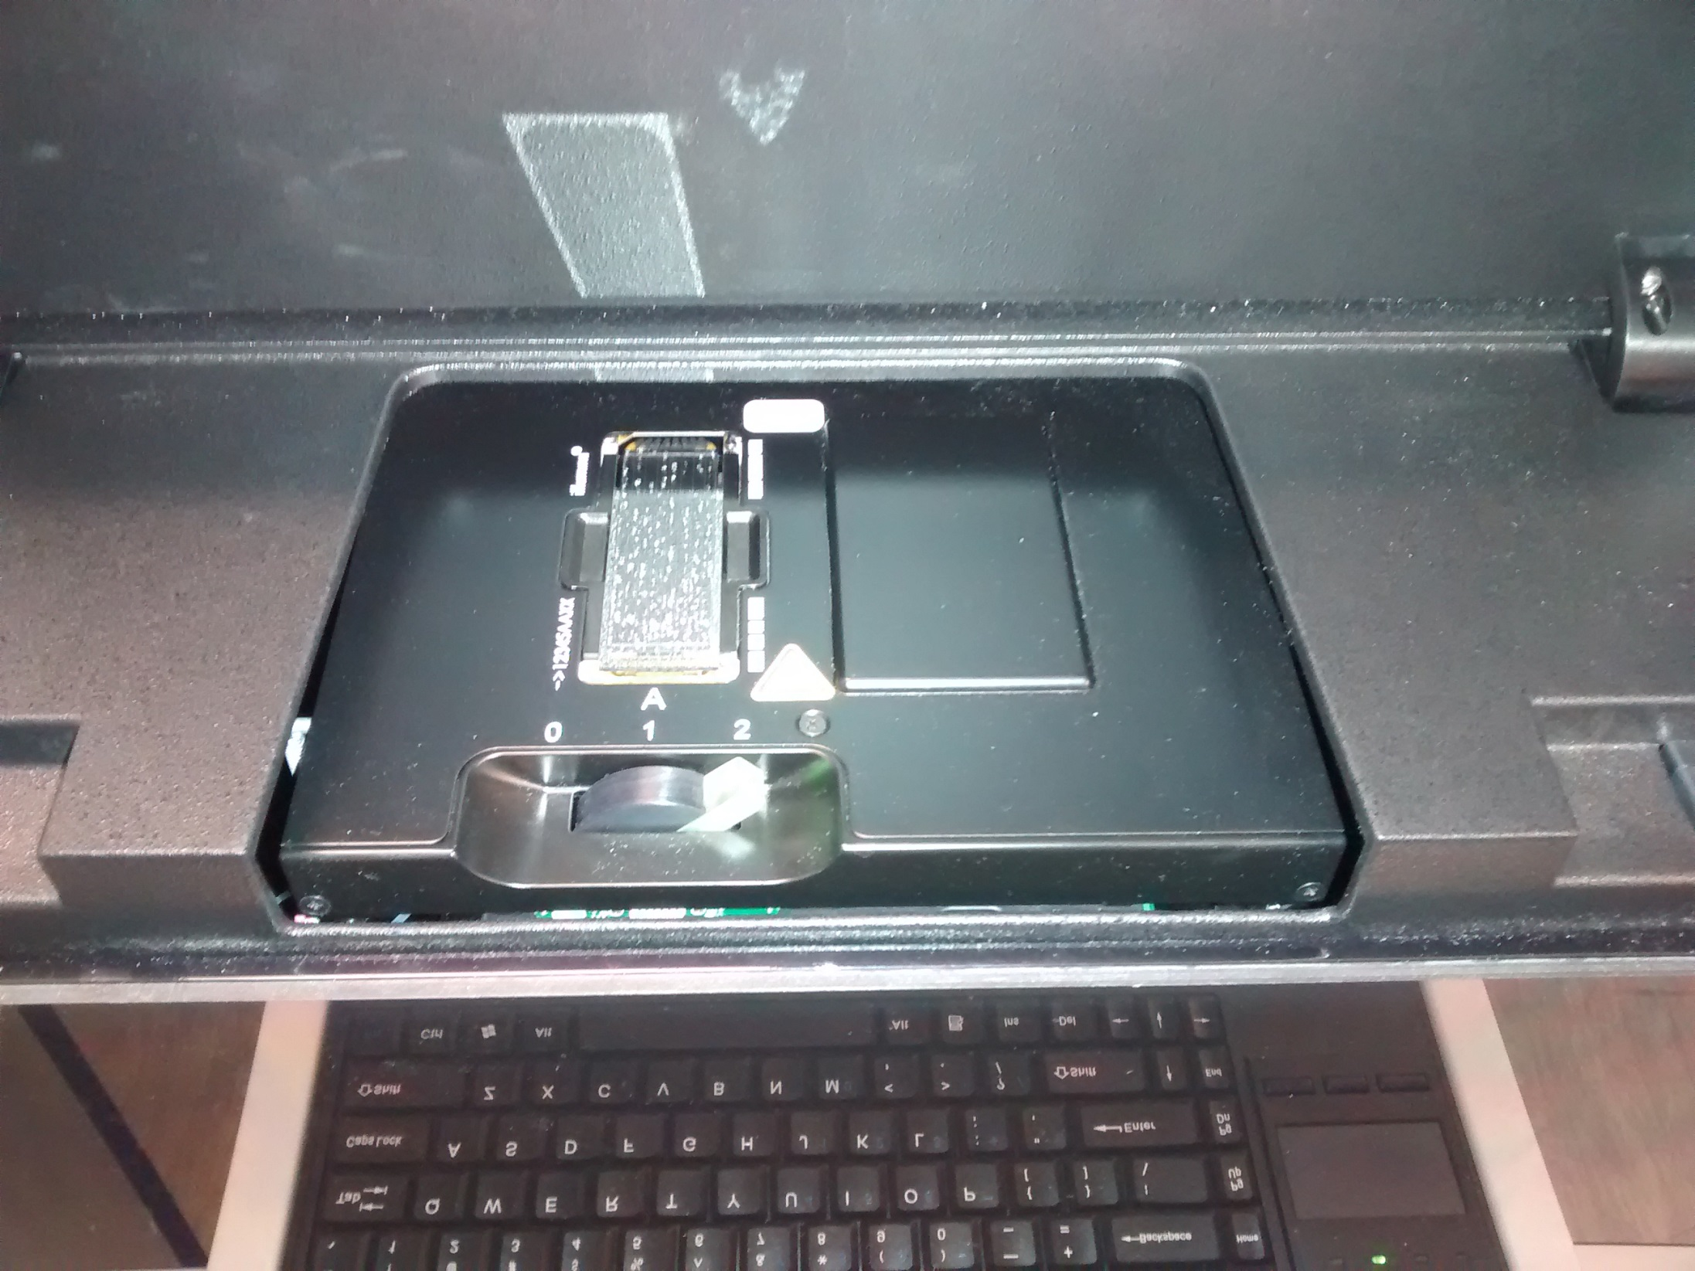
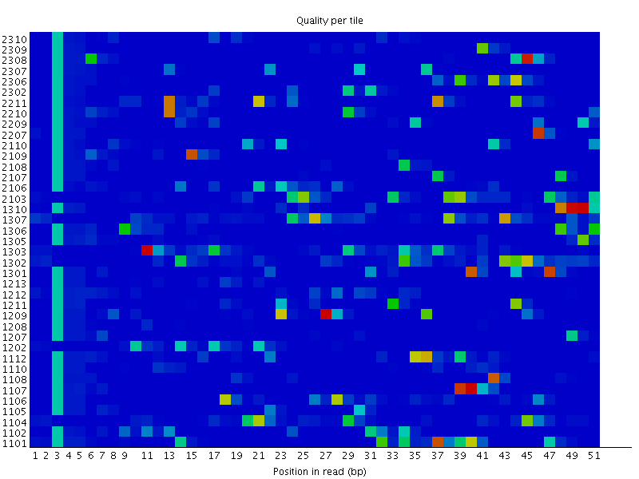
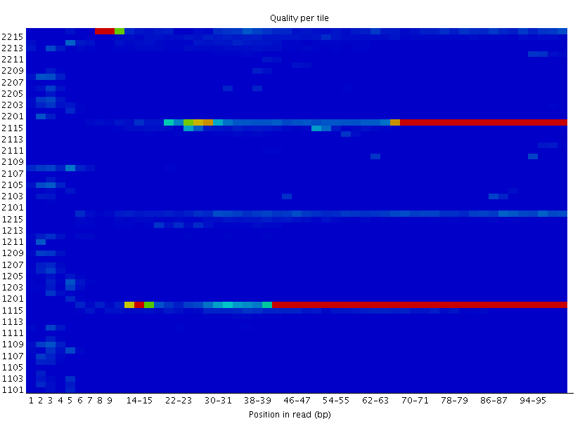
Positional Quality
Random Patterning
Tiles
Lanes
Top
Bottom
Position Specific
Patterning
Notes:
This graph will only appear in your analysis results if you're using an Illumina library which retains its original sequence identifiers. The graph allows you to look at the quality scores from each tile across all of your bases to see if there was a loss in quality associated with only one part of the flowcell.
The plot shows the deviation from the average quality for each tile. The colours are on a cold to hot scale, with cold colours being positions where the quality was at or above the average for that base in the run, and hotter colours indicate that a tile had worse qualities than other tiles for that base. A good plot should be blue all over.
Reasons for seeing warnings or errors on this plot could be transient problems such as bubbles going through the flowcell, or they could be more permanent problems such as smudges on the flowcell or debris inside the flowcell lane. Or flowcell is overloaded.

Slide 51
Duplication
The exact same sequence appears more than once in your library
The sequences come from different biological molecules and the duplication is coincidental
Deep sequencing
Highly present sequences (repeats for example)
Restricted diversity libraries (amplicon sequencing, restricted libraries)
The sequences come from the same biological and the duplication is technical
PCR duplicates

Slide 52
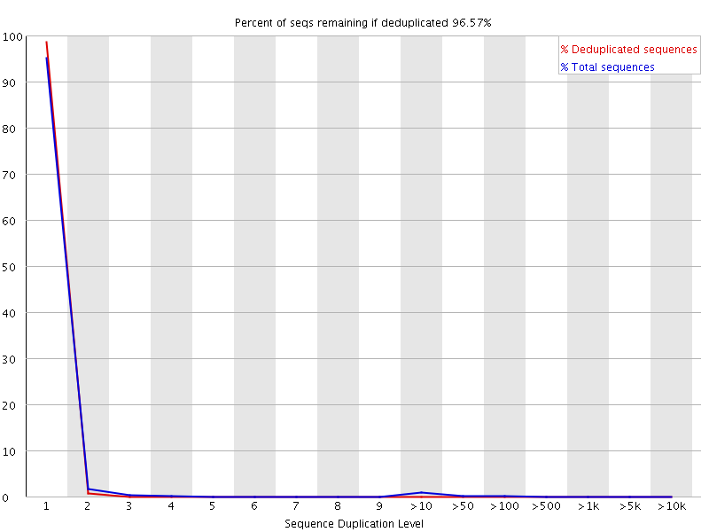
Duplication
Most sequences are unique
High diversity (or low coverage)

Slide 53
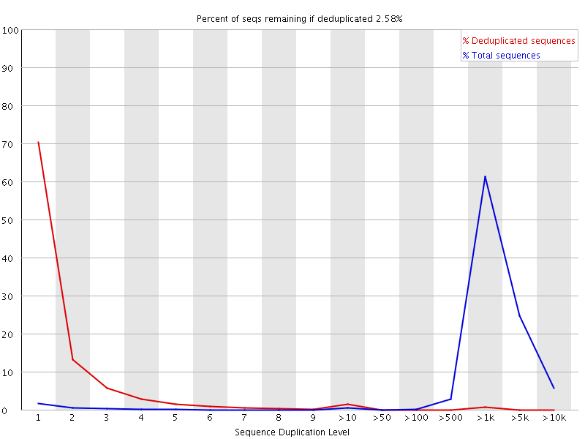
Duplication
Most sequences are present many times
Highly duplicated (low diversity)

Slide 54

Overrepresented Sequences
PolyA – Common in RNA-Seq
PolyG – Empty space in 2-colour chemistry
PolyN – Quality too poor to make any calls
Specific sequences – Normally Adapter Dimers
Notes:
Extreme duplication – the exact same sequence is a significant proportion of the whole library (which might not be duplicated overall).
Normally comes from artificial sequences (primers, adapters, vectors etc)
Can search a database of known sequences to find matches

Slide 55
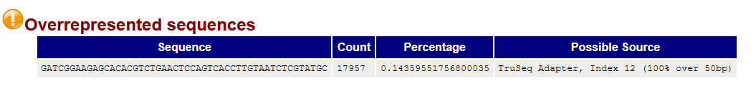
Adapter Dimers
Barcode
Adapter
Insert
Adapter
Barcode
Barcode
Adapter
Adapter
Barcode

Slide 56
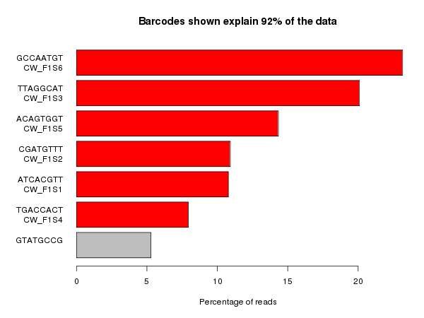
Barcode Sequences
Barcode
Adapter
Insert
Adapter
Barcode

Slide 57
Let’s run FASTQC

Slide 58
How Do you run a program on the VACC?
Install it in your personal VACC account and then be able to call it
Or load it from the shared computing cluster using module package

